Slide 1
Plant Anatomy and Physiology
What are the parts of the plant, and how do they work?

Slide 2
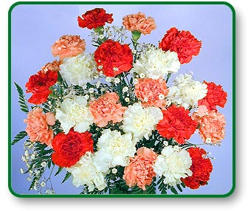
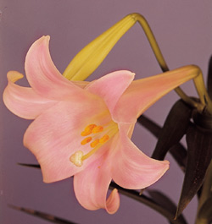
What is Classification
GROUPING things according to their CHARACTERISTICS

Slide 3
Plant Classification (5 Kingdoms)
ANIMAL
PLANT
FUNGI
BACTERIA (MONERA)
PROTISTS

Slide 4
Plant Classification
Non Flowering
  Ferns
  Cone-Producers (Conifers)
Flowering
  Monocots
  Dicots

Slide 5
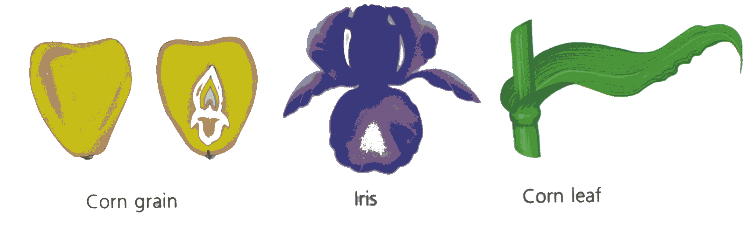
Monocots
Leaves have parallel Veins
Fibrous Roots
Flower parts in 3’s
Seed has one part (cotyledon)
Vascular bundles are scattered

Slide 6
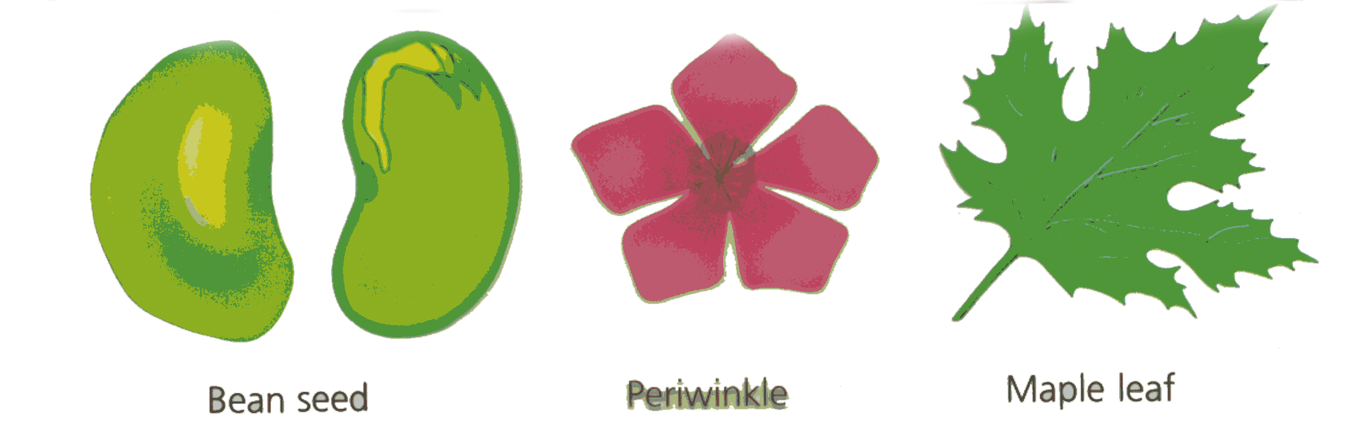
Dicots
Leaves have branched Veins
Tap Roots
Flower parts in 4’s & 5’s
Seed has two parts (cotyledons)
Vascular bundles are in a ring

Slide 7
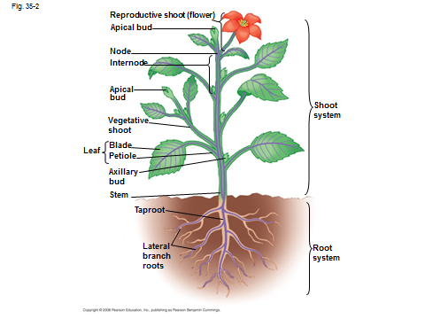
Major Plant Parts
Roots
Stems
Leaves
Flowers

Slide 8
Roots
Functions:
  Absorb water and nutrients
  Anchor the plant, and support the above ground part of the plant.
  Store food.

Slide 9
Roots
Root Systems:
  Fibrous: A system that has no dominant primary root.
  Tap: A system composed of one primary root and many secondary roots that branch off.

Slide 10
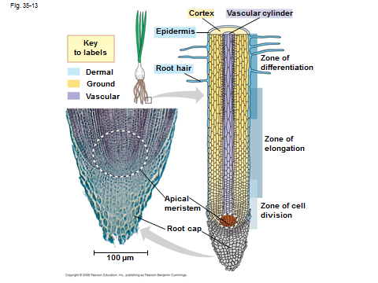

Slide 11
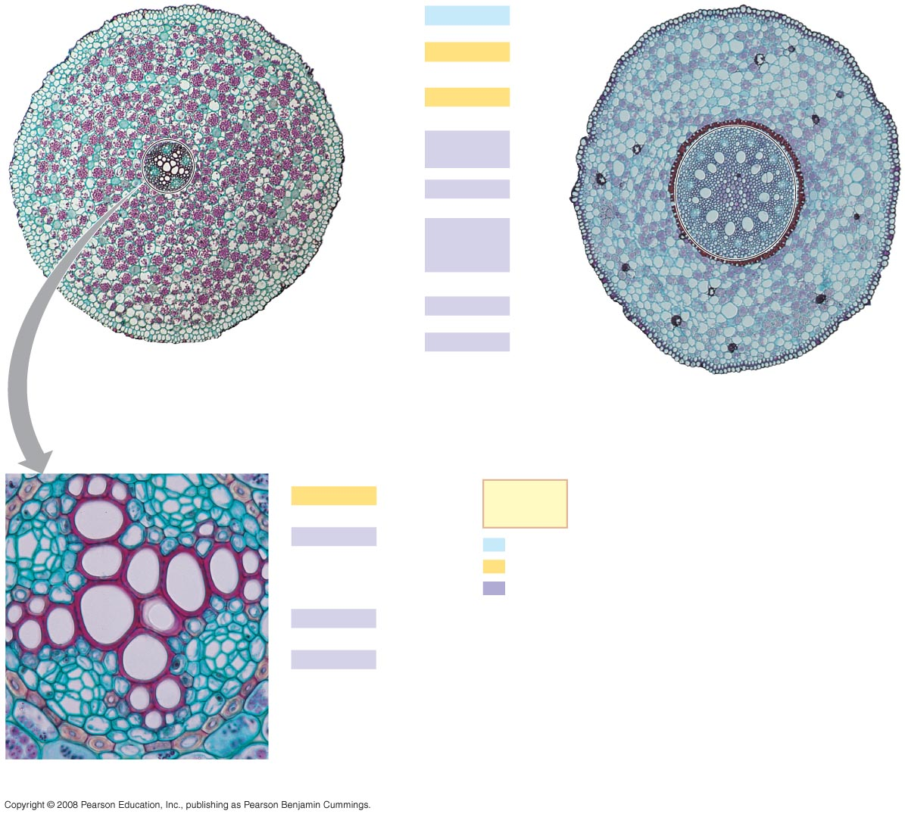
Fig. 35-14
Epidermis
Cortex
Endodermis
Vascular
cylinder
Pericycle
Core of
parenchyma
cells
Xylem
100 µm
Phloem
(a)
Root with xylem and phloem in the center
(typical of eudicots)
100 µm
(b)
Root with parenchyma in the center (typical of
monocots)
Endodermis
Key
to labels
Pericycle
Dermal
Ground
Vascular
Xylem
Phloem
50 µm
Notes:
Figure 35.14 Organization of primary tissues in young roots

Slide 12
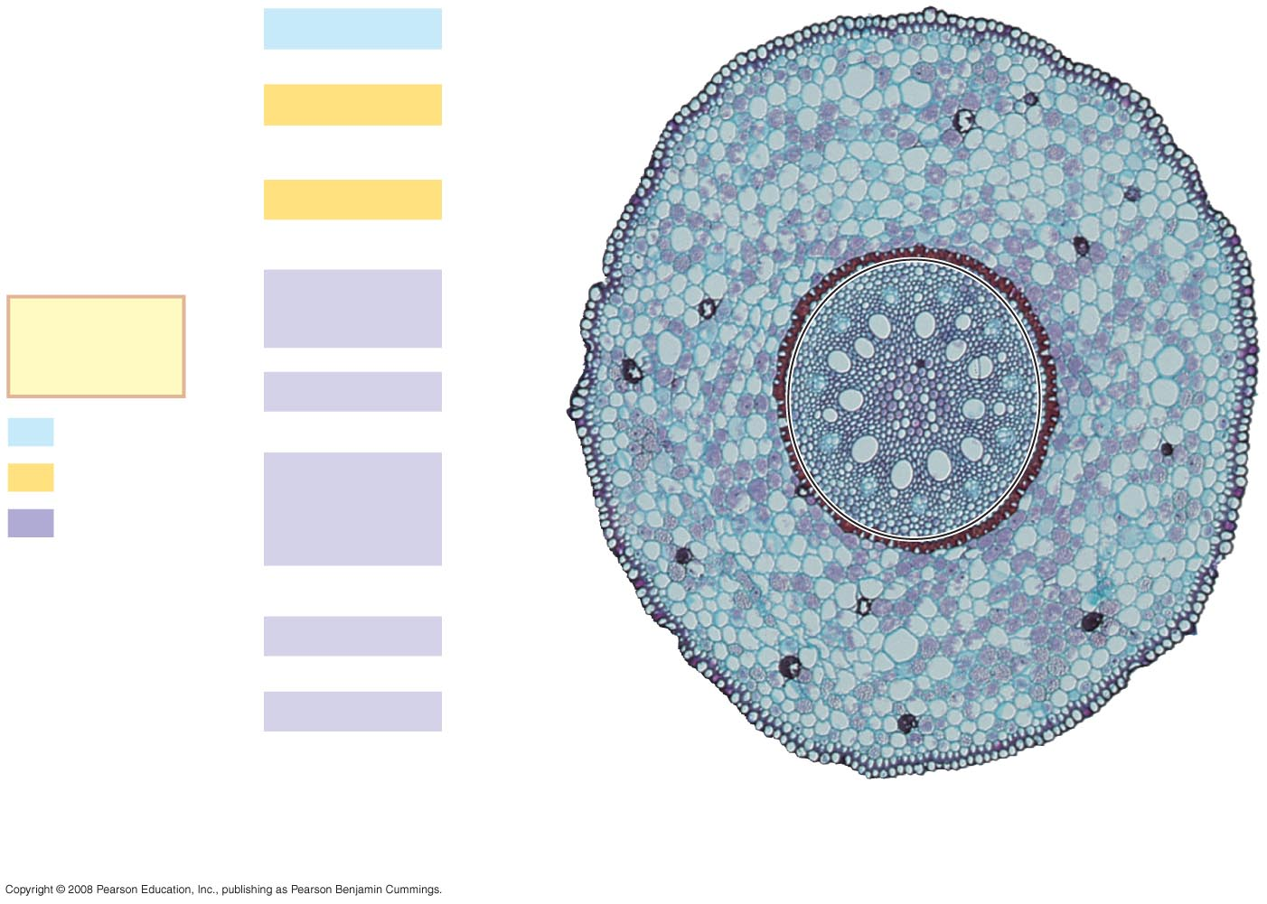
Fig. 35-14b
Epidermis
Cortex
Endodermis
Vascular
cylinder
Key
to labels
Pericycle
Dermal
Ground
Core of
parenchyma
cells
Vascular
Xylem
Phloem
100 µm
(b)
Root with parenchyma in the center (typical of
monocots)
Notes:
Figure 35.14 Organization of primary tissues in young roots

Slide 13
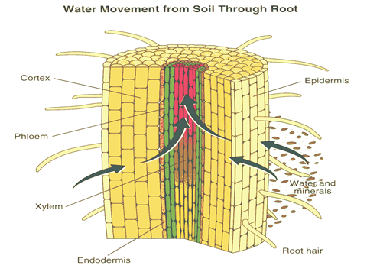

Slide 14
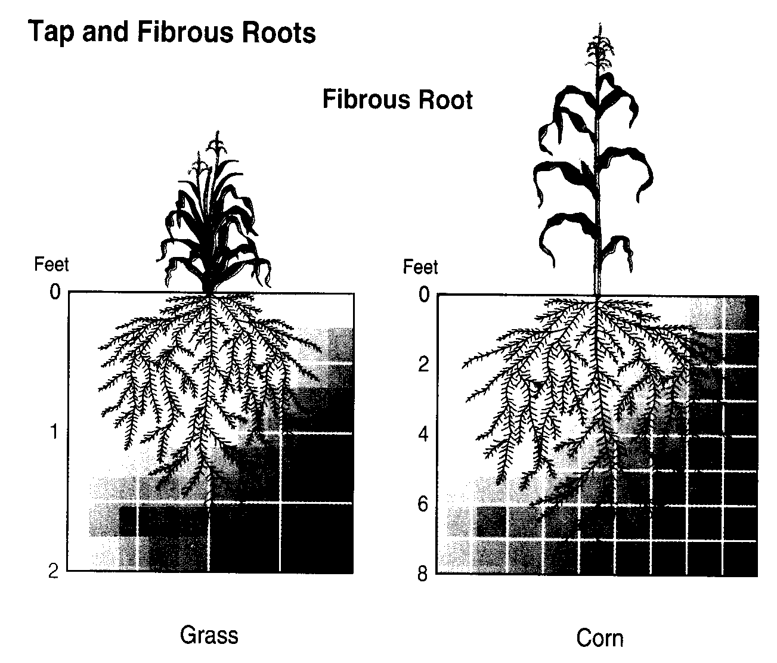
Fibrous

Slide 15
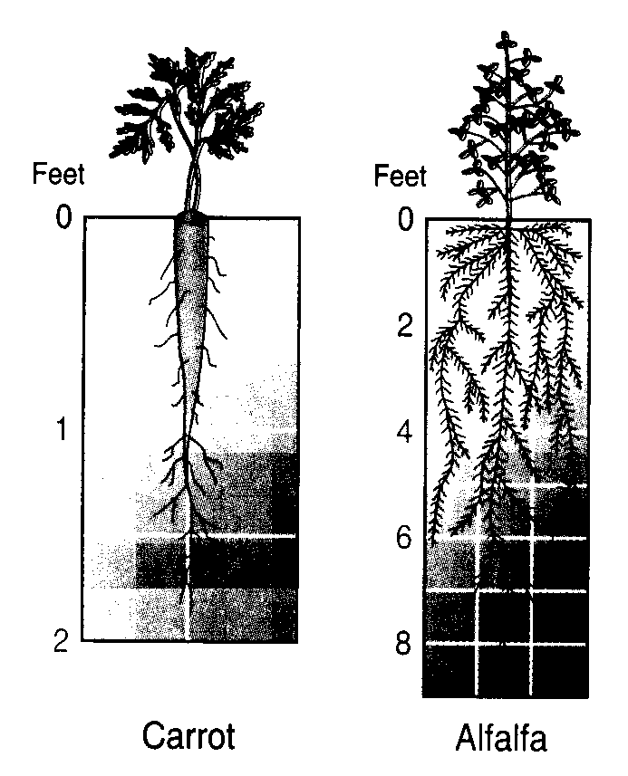
Tap Roots

Slide 16
Roots
Primary Root: The first root to emerge at germination. May become the main tap root.
Secondary Roots: Roots that branch out from the primary root.
Apical Meristem: Area at the tip of the root where new cells develop.

Slide 17
Roots
Healthy Roots: Roots are white or nearly white, and smell fresh.
Unhealthy Roots: Roots are black, brown, or dark orange and smell rotten and sour.

Slide 18
Stems
Functions:
  Support the leaves, and position them so they can receive as much sunlight as possible.
  Responsible for the size and shape of the plant.

Slide 19
Stems
Functions:
  Move water, minerals, and manufactured food throughout the whole plant.
  Green stems produce food through photosynthesis.

Slide 20
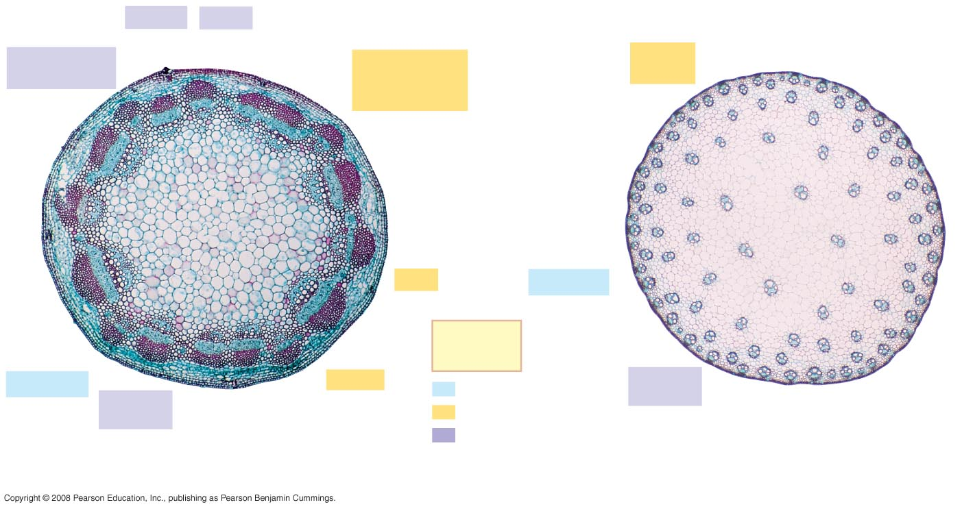
Fig. 35-17
Phloem
Xylem
Sclerenchyma
(fiber cells)
Ground tissue
connecting
pith to cortex
Ground
tissue
Pith
Epidermis
Key
to labels
Epidermis
Cortex
Dermal
Vascular
bundles
Vascular
bundle
Ground
1 mm
Vascular
1 mm
(a)
Cross section of stem with vascular bundles forming
a ring (typical of eudicots)
(b)
Cross section of stem with scattered vascular bundles
(typical of monocots)
Notes:
Figure 35.17 Organization of primary tissues in young stems

Slide 21
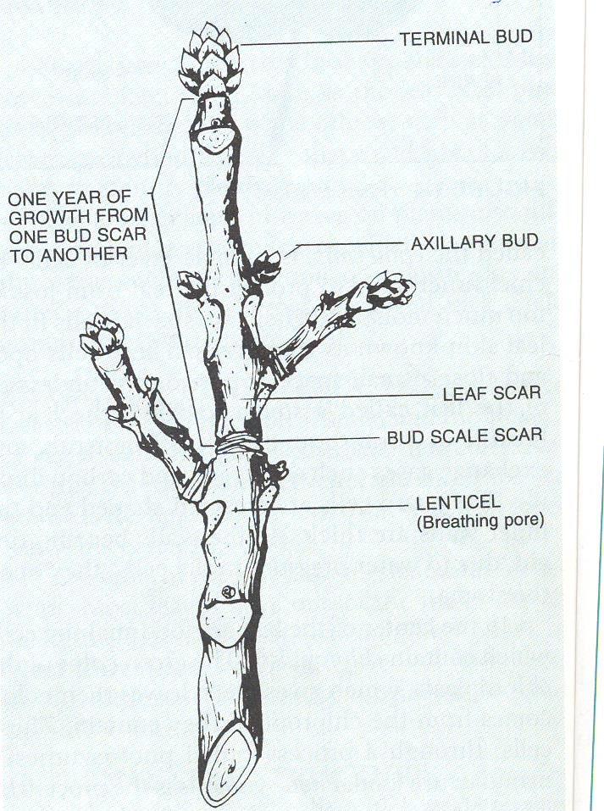

Slide 22
Stems
Internal Structures
  Xylem: Tissue responsible for carrying water and nutrients from the roots to the leaves. It is located near the center of the stem.
  Xylem Up!!

Slide 23
Stems
Internal Structure:
  Phloem: Tissue responsible for carrying food produced in the leaf to the rest of the plant. The phloem is usually located near the outside of the stem.
  Phloem Down!!

Slide 24
Stems
Internal Structure
  Cambium: Tissue responsible for the production of new xylem and phloem. It is found between the xylem and phloem.

Slide 25
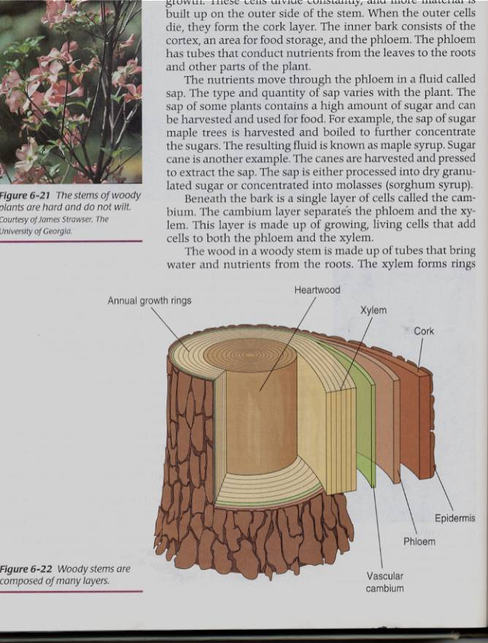

Slide 26
Stems
Specialized Stems
  Bulbs: Short flattened stem which has several fleshy leaves. Bulbs are found beneath the soil.
    Example: Onions
  Corm: Sphyrical structure similar to a bulb.
    Example: Gladiolus

Slide 27
Stems
Specialized Stems
  Rhizome: Thick underground stem which lies horizontally.
    Example: Mother in Law’s Tongue
  Stolon: Horizontal stem which lies above the ground (often called runners).
    Example: Strawberry runners

Slide 28
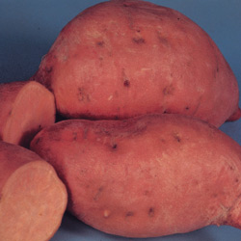
Stems
Specialized Stems
  Tuber: Rhizome with a tip that is swollen with stored food.
    Example: Potatoes.

Slide 29
Leaves
Functions:
  Produce food for the plants. They are designed to efficiently collect light and use that light to make energy.

Slide 30
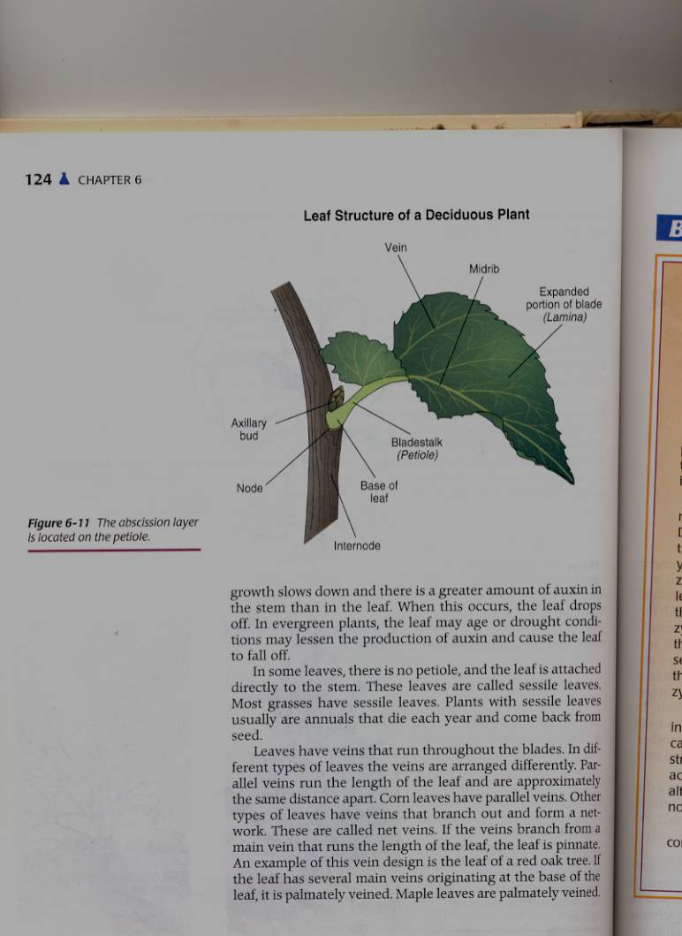

Slide 31
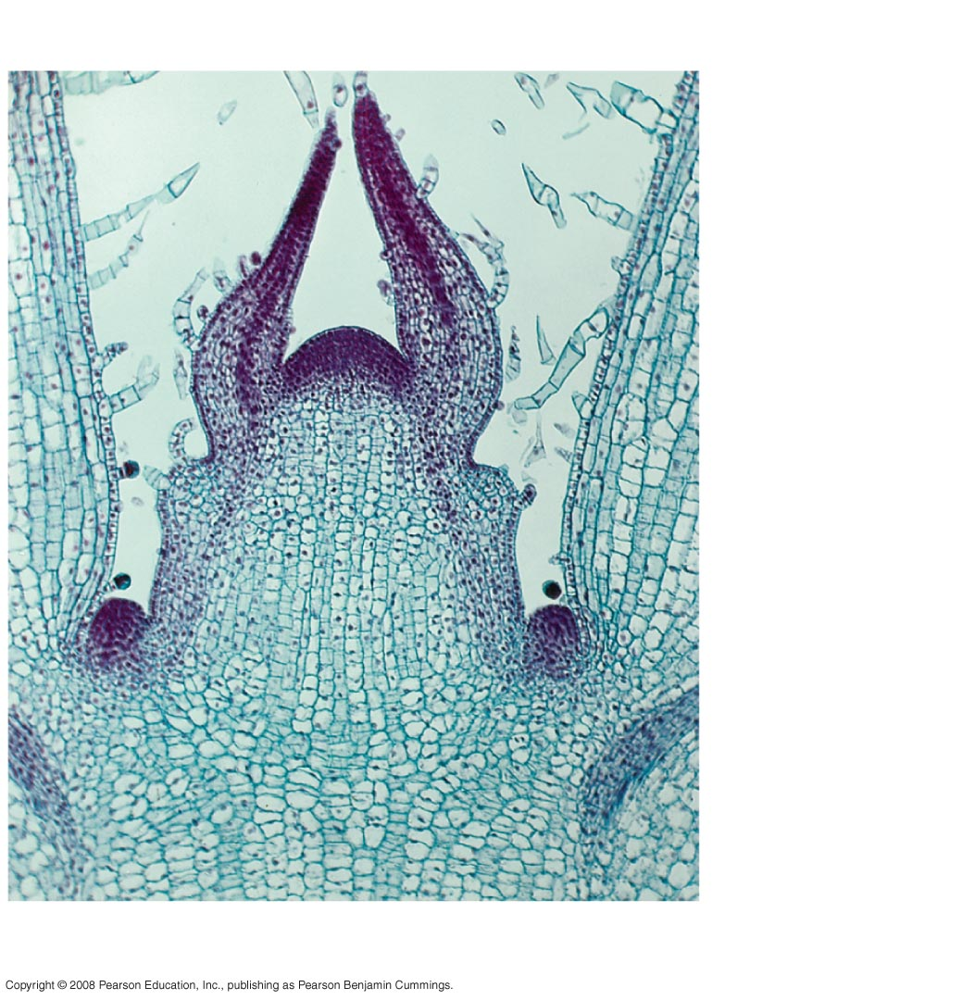
Fig. 35-16
Shoot apical meristem
Leaf primordia
Young
leaf
Developing
vascular
strand
Axillary bud
meristems
0.25 mm
Notes:
Figure 35.16 The shoot tip

Slide 32
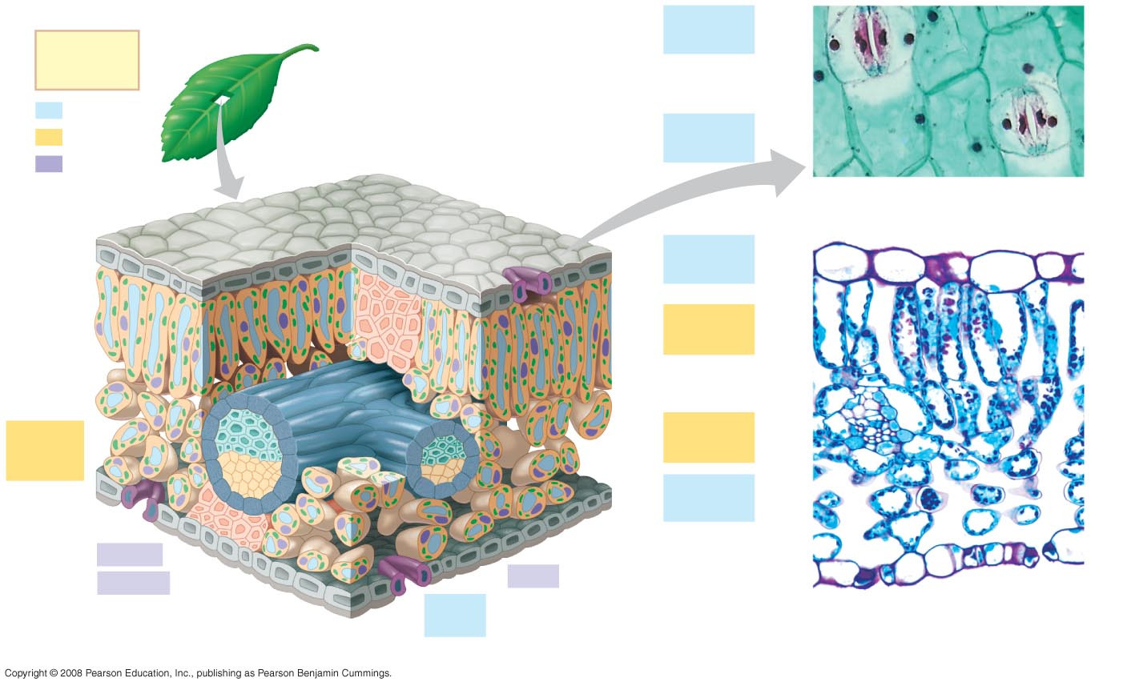
Fig. 35-18
Guard
cells
Key
to labels
Stomatal
pore
Dermal
50 µm
Ground
Epidermal
cell
Vascular
Cuticle
Sclerenchyma
fibers
Stoma
(b)
Surface view of a spiderwort
(Tradescantia) leaf (LM)
Upper
epidermis
Palisade
mesophyll
Bundle-
sheath
cell
Spongy
mesophyll
Lower
epidermis
100 µm
Xylem
Cuticle
Phloem
Vein
Guard
cells
Vein
Air spaces
Guard cells
(a) Cutaway drawing of leaf tissues
(c)
Cross section of a lilac
(Syringa)) leaf (LM)
Notes:
Figure 35.18 Leaf anatomy

Slide 33
Leaves
Leaf Parts
  Leaf Blade: Large, broad, flat surface whose job is to collect sunlight.
  Petiole: supports the leaf and holds it away from the stem.
  Midrib: Main vein running down the center of the leaf. It helps hold the leaf so it is facing the sun.

Slide 34
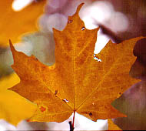
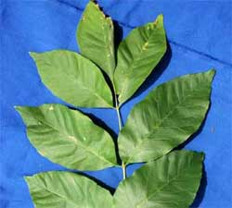
Leaves
Leaf Types
  Simple leaf: Has only one leaf on the petiole.
  Compound leaf: A leaf with multiple blades.

Slide 35
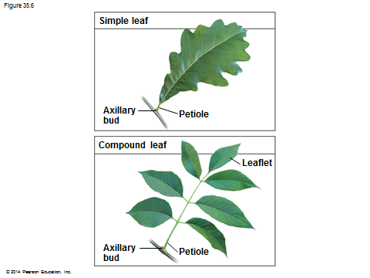

Slide 36
Leaves
Vein Patterns
  Parallel: Veins never cross. Found in monocots.
  Netted: Veins form a network. Found in Dicots.

Slide 37
Leaves
Leaf Layers:
  Cuticle: The top waxy, non-cellular part of the leaf. Its job is to prevent water escaping.
  Epidermis: Skin like layer of cells found on both the top and bottom of the leaf. Its job is to protect the leaf.

Slide 38
Leaves
Leaf Layers
  Palisade Mesophyll: A layer of cells standing on end directly below the upper epidermis. This area is responsible for photosynthesis.
  Spongy Mesophyll: Loosely packed cells located beneath the palasade mesophyll. This area is responsible for holding the products of photosynthesis.

Slide 39
Leaves
Leaf Layers
  Stomata: Holes in the lower epidermis responisble for gas exchange.
  Guard Cells: Surround the stomata’s which open and close them.

Slide 40
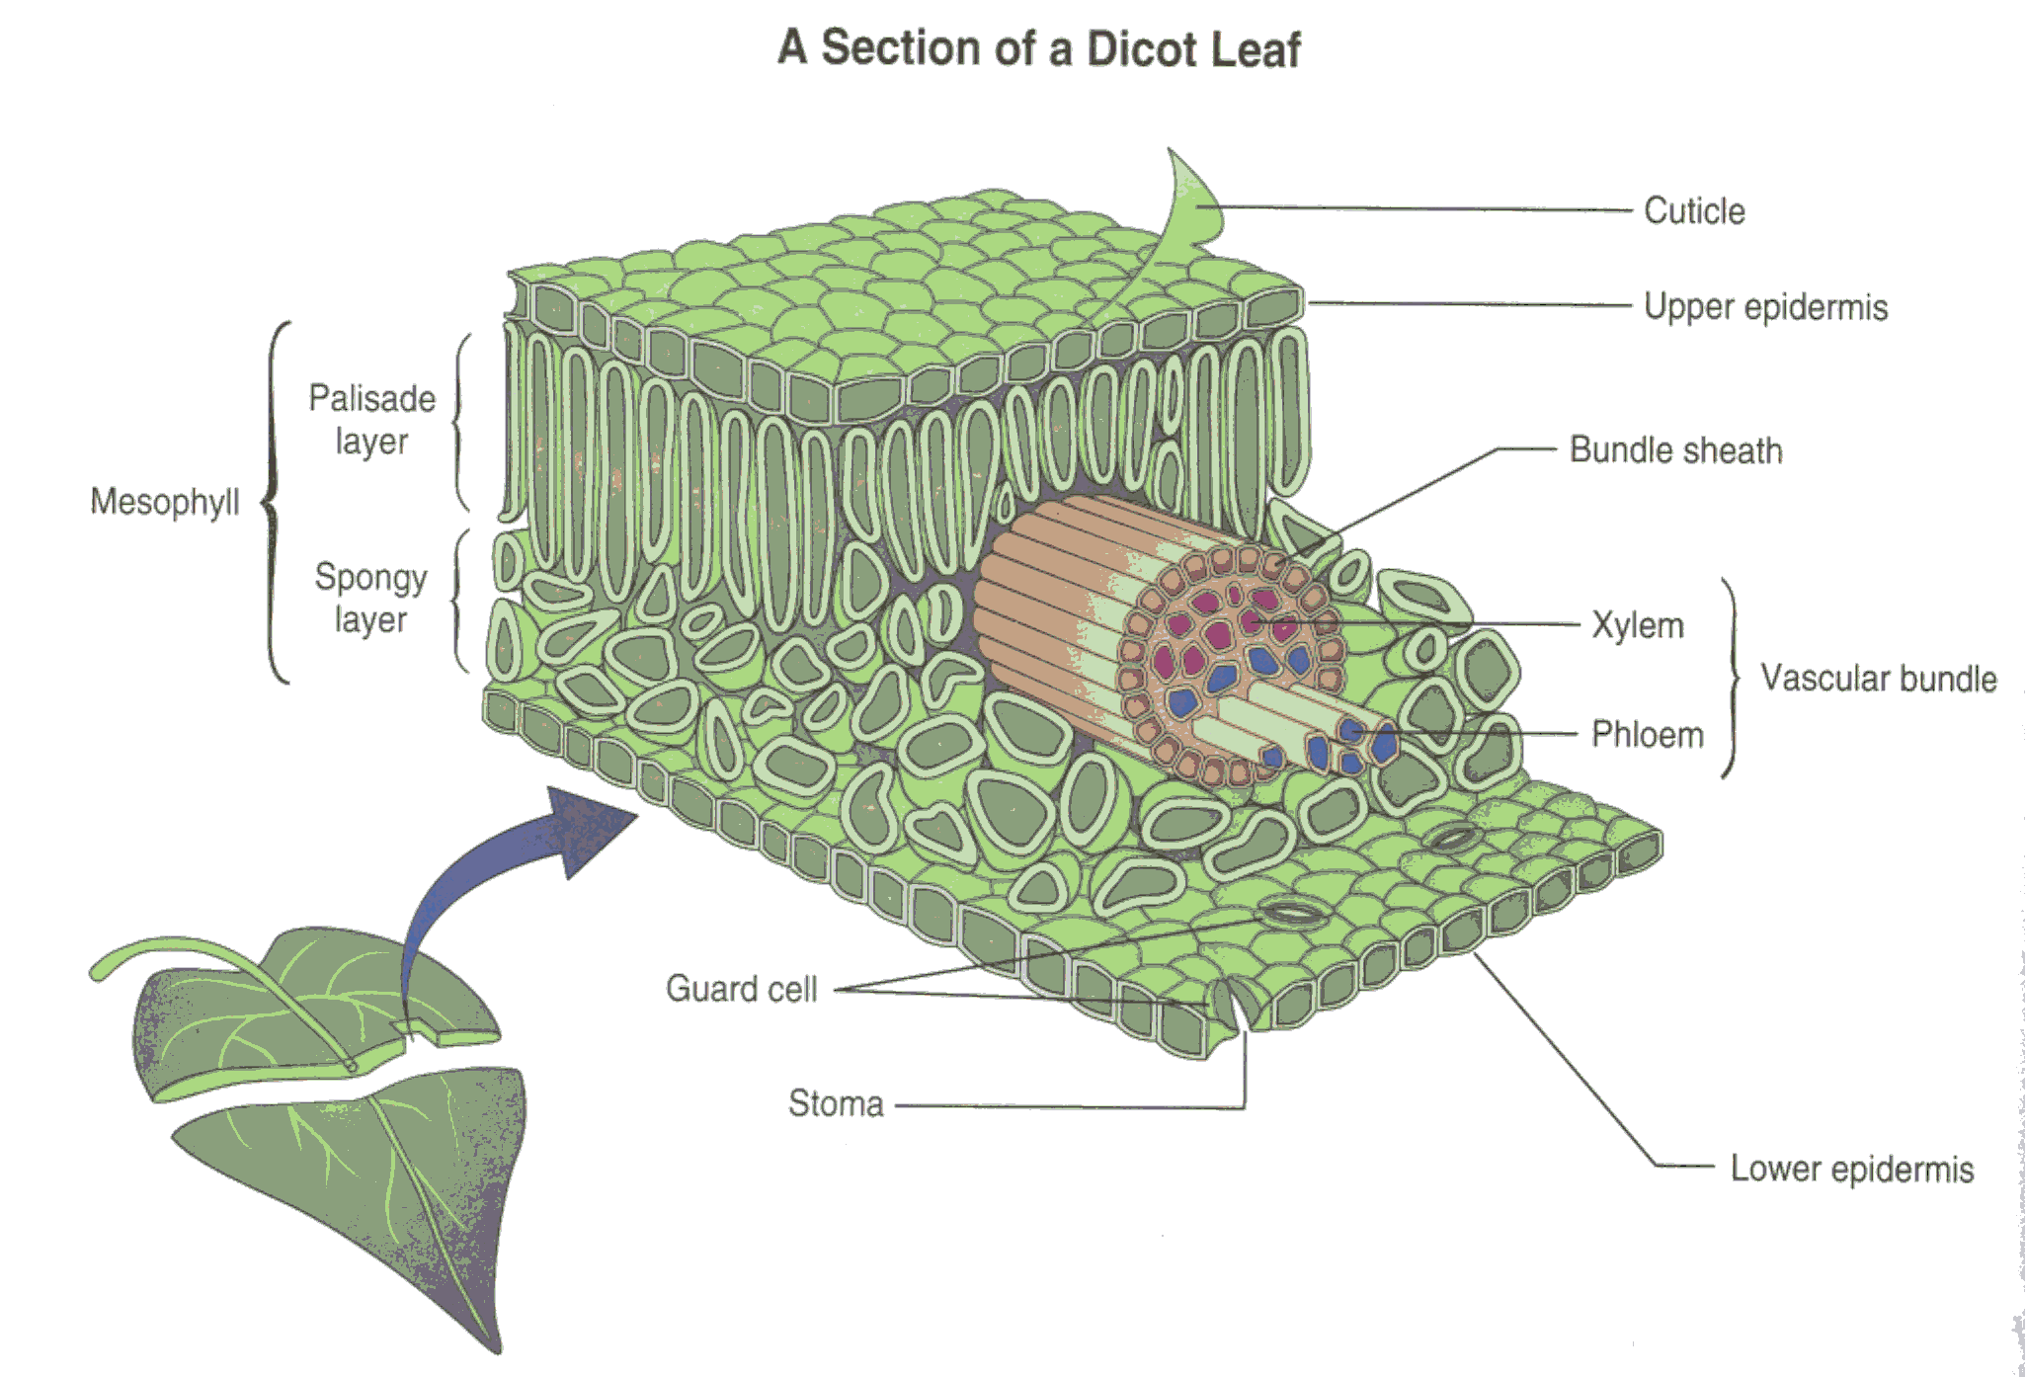
Leaf Layers

Slide 41
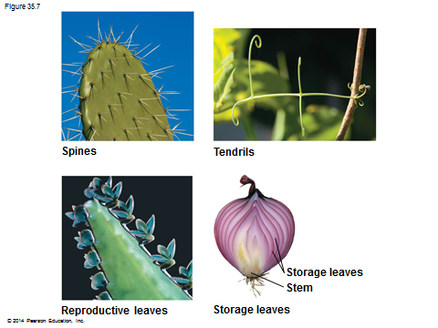

Slide 42
Photosynthesis
Photosynthesis: A chemical process by which a plant turns light energy from the sun into chemical energy in the form of sugar.

Slide 43
Photosynthesis
Photosynthesis
  The plant uses water and carbon dioxide to produce glucose (a sugar). The by product of photosynthesis is oxygen.
  These chemical reactions take place inside the cells near the chloroplasts. Chloroplasts are filled with Chlorphyll which makes the plants green.

Slide 44
Photosynthesis
Photosynthesis
  Plants don’t photosynthesize. Chloroplasts do! Plants just happen to be lucky enough to have chloroplasts in their cells.

Slide 45
Respiration
Cellular Respiration: The opposite of photosynthesis. This process breaks sugars down so plants can use them.
  Similar to digestion in animals.
  Takes place in a place in the cell called the mitochondria.

Slide 46
Respiration
How are photosynthesis and respiration important to us as human beings?

Slide 47
Flowers
Flower Parts -- Male
  Stamen: Male part of the flower.
  Filament: Stalk like in the stamen that holds up the anther
  Anther: Sack-like structure that contains pollen.

Slide 48
Flowers
Flower Parts -- Male
  Pollen grains are released from the anther that contains sperm.
  Staminate: Flowers that have only male parts.

Slide 49
Flowers
Flower Parts – Female
  Pistil: Female part of the flower
  Stigma: Sticky part of the pistil that is receptive to pollen.
  Style: Rod shaped middle part that has a swollen base (ovary) containing eggs

Slide 50
Flowers
Flower Parts – Neither male or female
  Petals: colorful leaf-like structures which attract animals and insects.
  Corolla: When all of the petals are fused together.
  Sepals: Green leaves that protect the flower before it opens.

Slide 51
Flowers
Flower Parts – Niether male or female
  Calyx: When all of the sepals are fused together.

Slide 52
Flowers
Sexual Reproduction in Plants: Two parents (meiosis)
  #1 The stamen releases pollen.
  #2 Pollen is carried by wind, gravity, animals, or insects to the stigma of another flower. (This is when pollination occurs)
  #3 The pollen moves from the stigma down through in a pollen tube the style depositing sperm in the ovary.

Slide 53
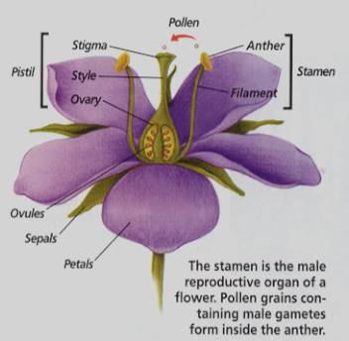

Slide 54
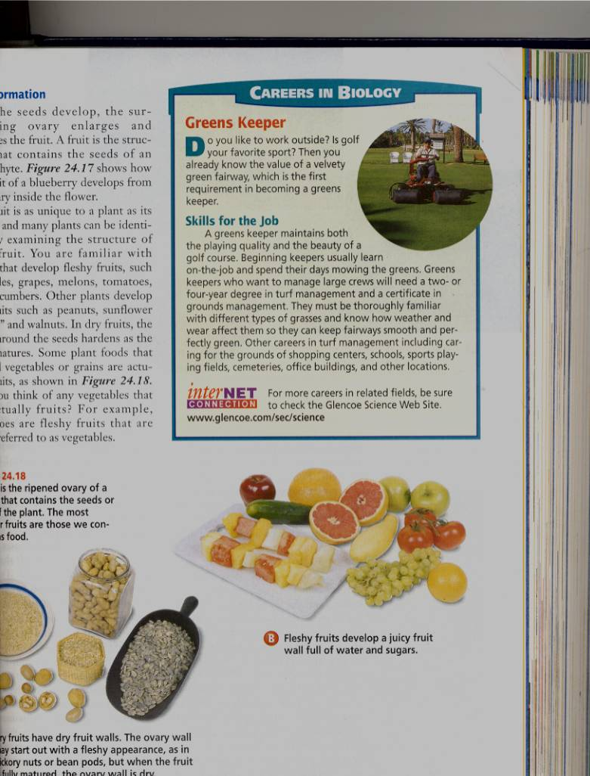
Flowers
Sexual Reproduction in Plants:
  #4 When the sperm has been deposited in the ovary fertilization has occurred.
  #5 When the eggs have been fertilized, the ovary and surrounding tissue start to enlarge to become a fruit and the fertilized eggs become seeds.

Slide 55
Flowers
Flower Types:
  Perfect Flower: Has both male and female parts.
  Imperfect Flower: A flower that is missing either male or female parts.
  Complete Flower: Flowers that have sepals, petals, pistils, and stamens.

Slide 56
Flowers
Flower Types:
  Incomplete Flowers: When a flower is missing sepals, petals, pistils, or stamen.
  Imperfect Flowers are always incomplete. Incomplete flowers may or may not be imperfect

Slide 57
Light
Plants need the colors blue and red to activate chlorophyll.
Light bulbs are deficient in the color blue.
Fluorescent tubes are deficient in the color red.

Slide 58
Light
Special grow lights are made that carry the correct blue and red wavelengths.
Light intensity is measured in foot candles.
Foot Candle: The amount of light given off by a candle a foot away.

Slide 59
Light
Plants have adapted to survive in either high, partial, or low light intensities.

Slide 60
Light
Photoperiod: The length of daylight.
Short Day Plants: Plants that begin to flower when the nights are over 12 hours long.
Long Day Plants: Begin to flower when the nights are under 12 hours long.
Neutral Plants: Flowering response is unaffected by day length.

Slide 61
Temperature
Hardiness: A plants ability to withstand cold temperatures.
Hardiness is measured using the USDA hardiness Zone Map.

Slide 62
Temperature
Wilting: A condition caused by excess heat and dryness. When a plant wilts it closes its’ stomatas, and the cells loose their turgor pressure.

Slide 63
Air
Oxygen: Is needed by the plant for respiration. It is obtained by the roots.
Carbon Dioxide: Is needed by the plant for photosynthesis. It is obtained through the stomata’s

Slide 64
Water
Plants get most of the water through their roots. Some small quantities are also obtained through the stems.
Difficult task about watering: Plants need both adequete levels of water and oxygen.

Slide 65
Water
Plants should be watered all the way through the root zone to encourage even root growth.
Plants should be grown in pots with drainage holes so the water can drain and allow oxygen into the root zone.

Slide 66
Growth Regulators
Plant hormones: growth regulators naturally produced by the plant.
  Auxins: Growth hormones produced by the apical meristem. They encourage height growth, and discourage lateral growth.

Slide 67
Growth Regulators
Plant Hormones:
  Cytokinins: Produced in roots and seeds, and are responsible for cell division and differentiation.
  Ethylene: Produced by ripening fruit, it stimulates flowering, and ripening.

Slide 68
Growth Regulators
Plant Hormones:
  Gibberellins: Produced in stems, roots, and young leaves. They are responsible for internodal elongation.
  Abscisic Acid: Found in seeds. A hormone which inhibits growth.

Slide 69
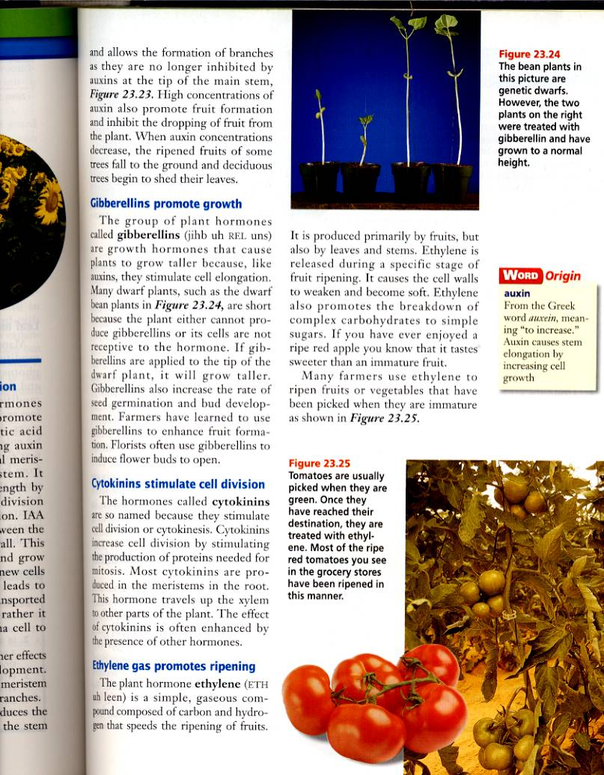
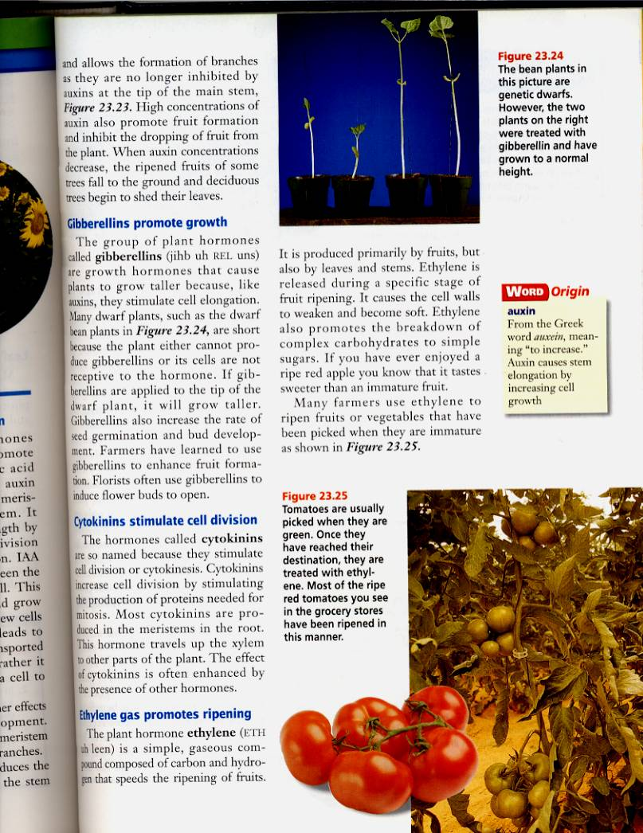
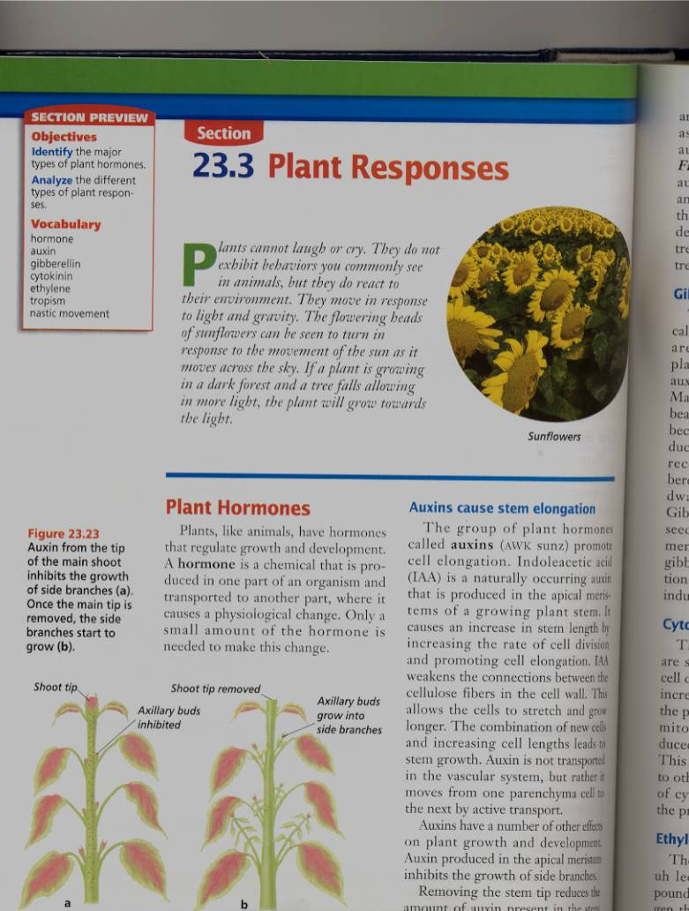
Giberrellins Effect on dwarf bean plants
Ethylene
The effect of Auxins

Slide 70
Growth Regulators
Commercial Uses:
  A-rest, B-Nine, Cycocel, Florel: Used on poinsettias, Easter Lilies, and Chrysanthemums to reduce size to make a shorter bushier, and more attractive plant.
  Rootone and Hormodin: Used to help plants root more quickly.

Slide 71
Growth Regulators
Commercial Uses:
  Ethylene gas: Used to ripen bananas when they get to market. Used to induce flowering in pineapple crops.

